Slide 1
CUS1166 – Technology Presentation
Flask-User
Customizable User Account Management for Flask
By: Salman Butt
Dr. Christoforos Christoforou

Slide 2
Purpose/Goal
Authenticate Users
Handle Registrations and Email Confirmations
Change Usernames, Change Passwords, Forgotten Passwords
Also offers Added Security, Increased Reliability, Role-Based Authorization, Internationalization, and Support for Multiple Emails per User
Fully Customizable through customizable functions and email templates

Slide 3
Use Case/Application of Technology
Customizable Login Pages
Login using Gmail Account
Login using Facebook Account
Authorized access pages for members
Ex: Only members who pay can access a certain page
Role-Based Authorization
Ex: only the admin can access a certain webpage
Ex: only users that fit a certain role can access a certain page

Slide 4
Getting Started - Installation
Create a virtual environment for your project
pip install flask-user==0.6.15
pip install flask-mail

Slide 5
Getting Started – User DataModels
Flask-User allows developers to store Authentication, Email and User information in one DataModel or across several DataModels
Distinguishes between the following groups of user information:
User Authentication information such as username and password
User Email information such as email address and confirmed_at
User information such as first_name and last_name
User Role information
Requires User Role information to be stored in a Role DataModel and a UserRole association table

Slide 6
Getting Started – Authorization
The process of specifying and enforcing access rights of users to resources
Flask-User offers role based authorization through the use of function decorators:
@login_required
@roles_required
Required Tables; must have following models:
The usual User model with an additional ‘roles’ relationship field
A Role model with at least one string field called ‘name’
A UserRoles association model with a ‘user_id’ field and a ‘role_id’ field
Ex: Roles Based App

Slide 7
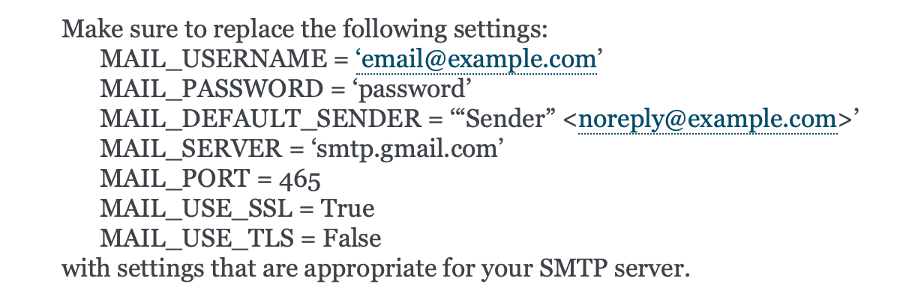

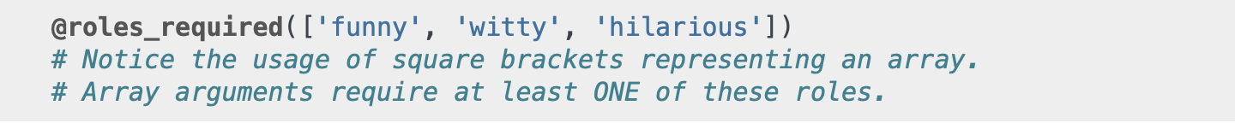
Application of Technology
Basic App & Authorization App
Register with username and email
Email confirmation
Login with username or email, Logout
Protect pages from unauthorized access
Forgot password
Roles Required App
Create 'user007' user with 'secret' and 'agent' roles
Store user and roles

Slide 8
Recap Key Concepts
Authenticate Users
Create Login Pages
Users can register with email or usernames, or both
Forgot password, change username, change password
Secure password hashing
Logout
Protect Pages from Unauthorized Access
Role-Based Authorization
Members, Admin, etc.

Slide 9
Resources for Further Reading
Flask-User GitHub: https://github.com/lingthio/Flask-User.git
Documentation: https://flask-user.readthedocs.io/en/v0.6/index.html
Using Flask-Login for User Management with Flask: https://realpython.com/using-flask-login-for-user-management-with-flask/
Customization: https://flask-user.readthedocs.io/en/v0.6/customization.html
User Authentication: https://www.youtube.com/watch?v=BnBjhmspw4c

Slide 10
Q&A

